Slide 1
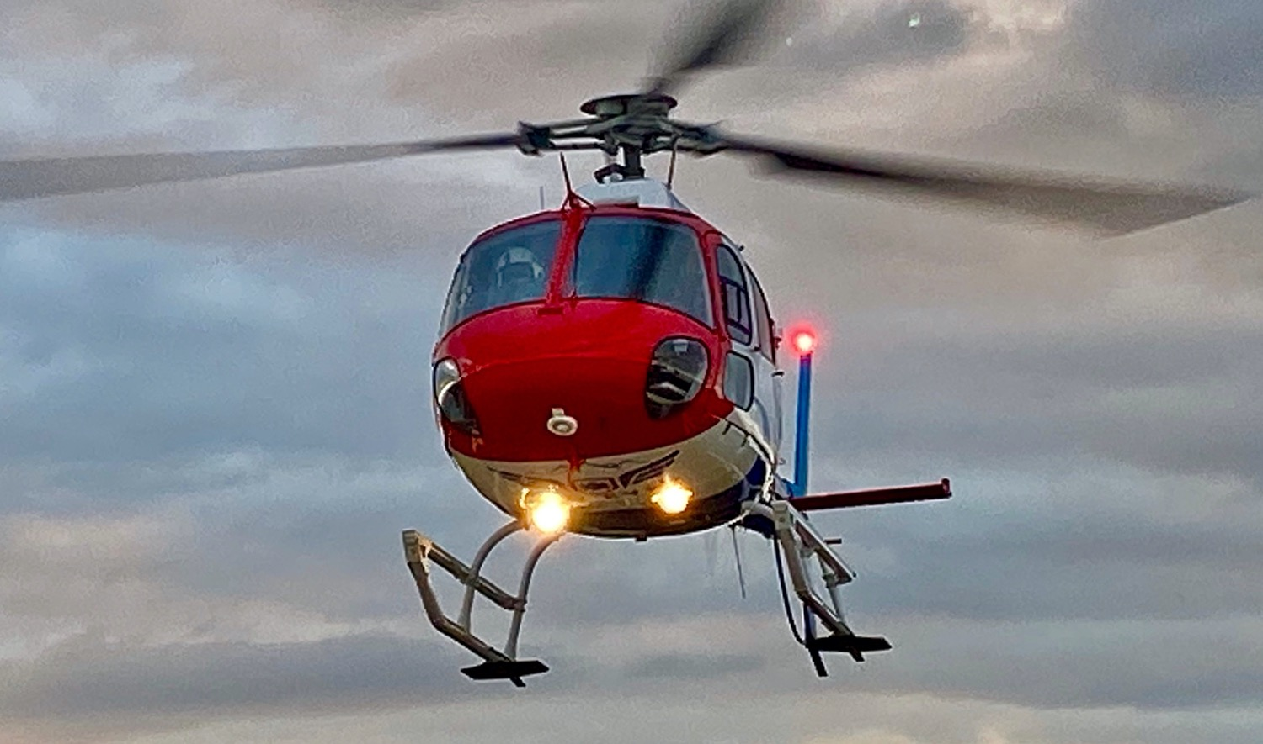
Helicopter Safety Search Assist Program
Updated 5/14/20

Slide 2
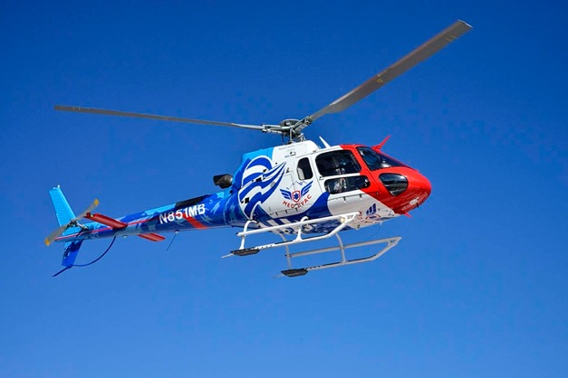
Who we are
Safety above all else
Clinical excellence
Founded in 1982
Three rotor-wing bases
Nurse/Paramedic/Pilot crew configuration
Dedicated communications center
Partners:
Med-Trans Corporation
Banner Health
Children’s Hospital Colorado
Boulder Community Hospital

Slide 3
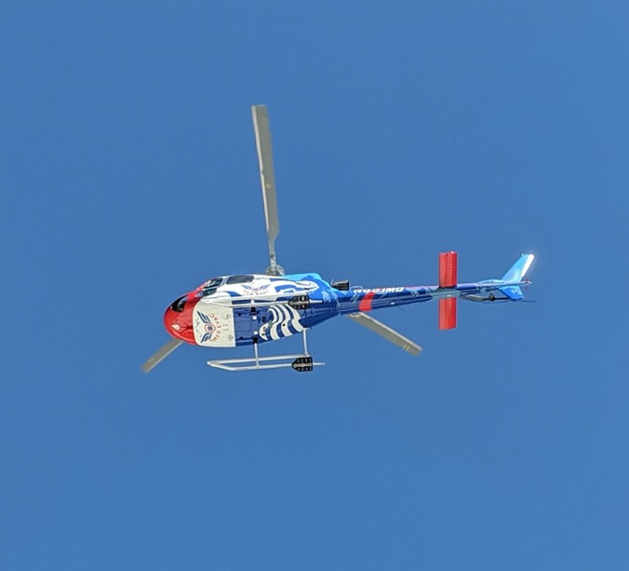
Our Helicopters
AS350B3e
FAA Safety Enhancements
Night Vision Goggle Equipped
High-altitude rated
Longs Peak (14,259’)
Radio Comms/Sat Phone

Slide 4
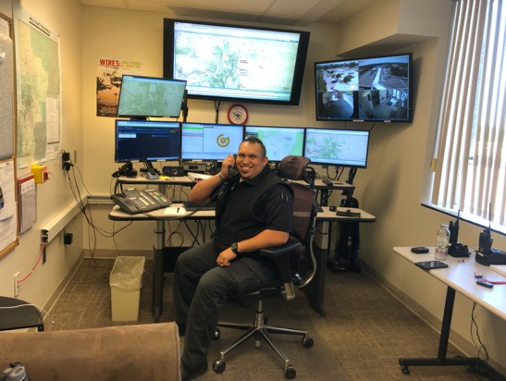
When To Call
Time-dependent injury or illness
Prolonged extrication or rescue
Critical-care scope of practice
Specialty care: pediatrics, neuro, trauma, OB, burns
Remote locations/backcountry insertion and evacuation
Grid searches/recon flights

Slide 5
How To Call
1-800-247-5433
Dispatch-to-Dispatch communication via AIRNET
Type of request
Go
Ground vs Air Standby
Stand-down
Grid Search
Backcountry Insertion
GPS Coordinates, intersection, physical address
LZ information
Ground Contact Name and Radio Frequency
Patient weight
Call nature
Med Evac helicopter availability

Slide 6
Flights in Weather
Visual flight rules (VFR)
Med-Trans visibility and ceiling minimums
Instruments for emergencies
No icing conditions
Effects of temperature and altitude on all aircraft
Participation in regional notification system for weather turndowns

Slide 7
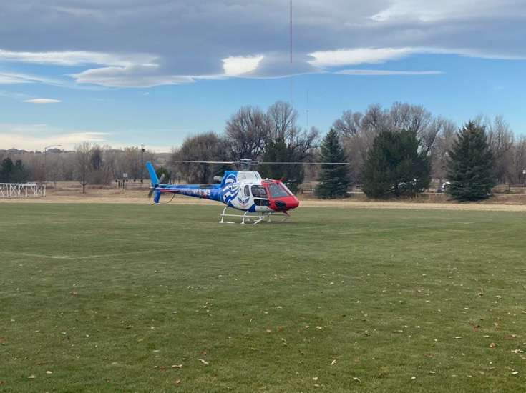
Landing Zone Setup
Remember SWORD
S - Size, surface, slope
100 ft x 100 ft
Walk it out
8° slope
W - Winds
Direction and speed
O - Obstacles
Overhead lines, poles, trees up to several hundred feet out
R - Route
Ingress/egress
D – Double-check
When in doubt, point it out!

Slide 11
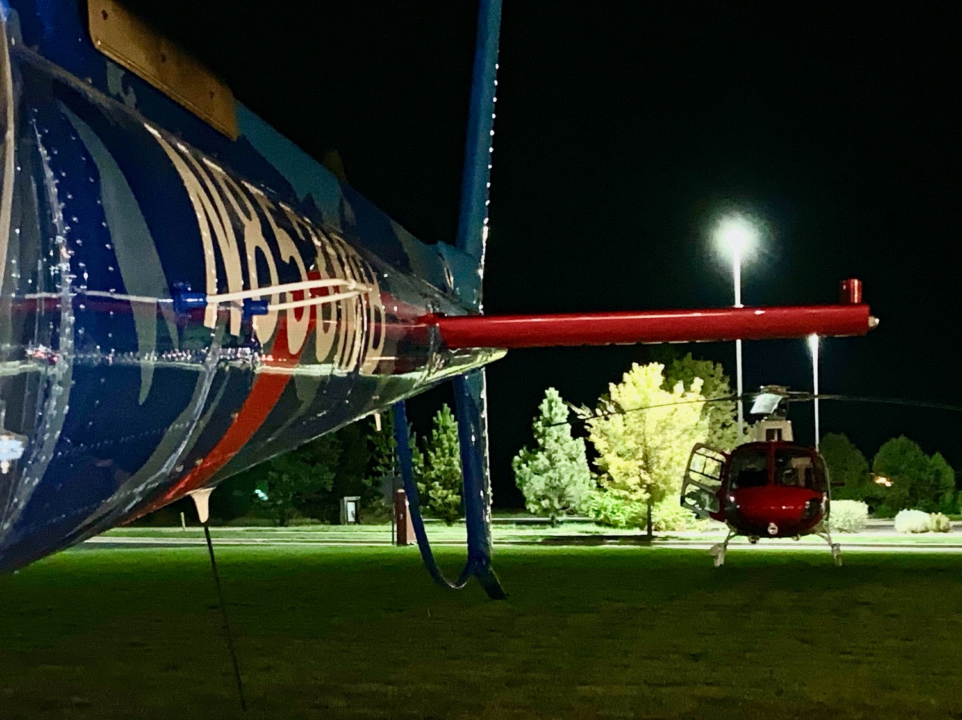
MED EVAC - HELICOPTER SAFETY AND SEARCH ASSIST TRAINING
11

Slide 12
NORTH COLORADO MED EVAC - HELICOPTER SAFETY AND SEARCH ASSIST TRAINING 12

Slide 13
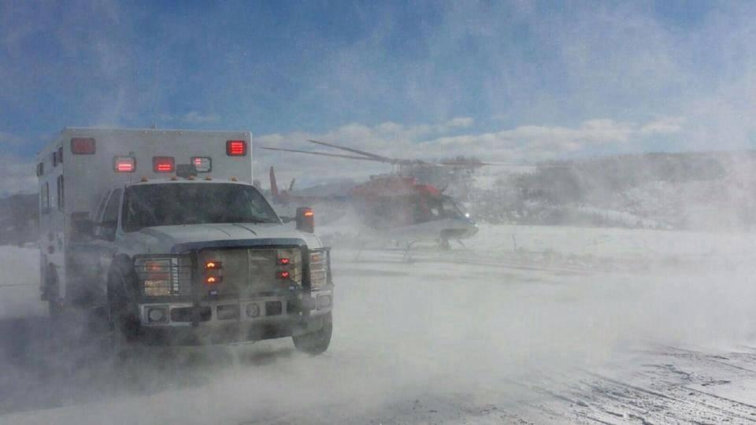

Slide 14
LZ Diagram

Slide 15
Lighting the LZ

Slide 16
Ground-to-Air Communications
Prior to landing
Remember SWORD
LZ identifiers
Identify hazards
Identify height and location of all obstacles
Common reference/landmark or “o’clock” reference from pilot
Wind speed and direction
Describe landing surface

Slide 17
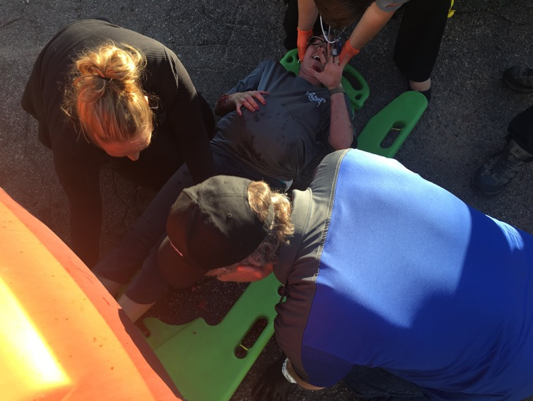
Patient Packaging
Maintain safe distance
Remove loose clothing/hats
Avoid loose blankets/belongings
Protect patient from debris (rotor wash)
Splints and boards

Slide 18
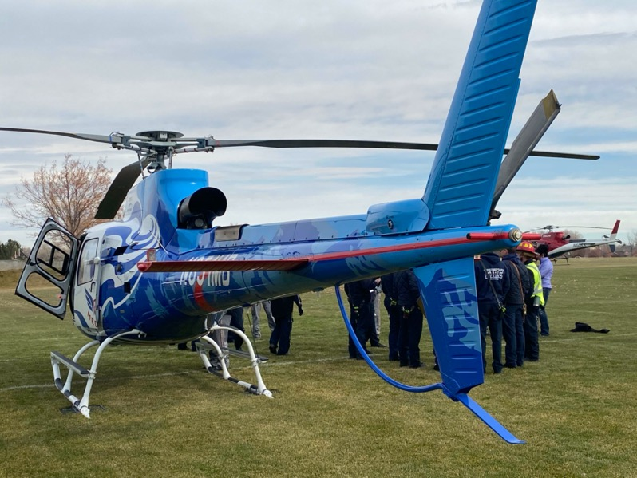
Tail Rotor Guard
Assign tail rotor guard
Out of danger zone
Stay in view of pilot
Keep people, vehicles or animals away from tail rotor

Slide 19
Approaching the Helicopter

Slide 21
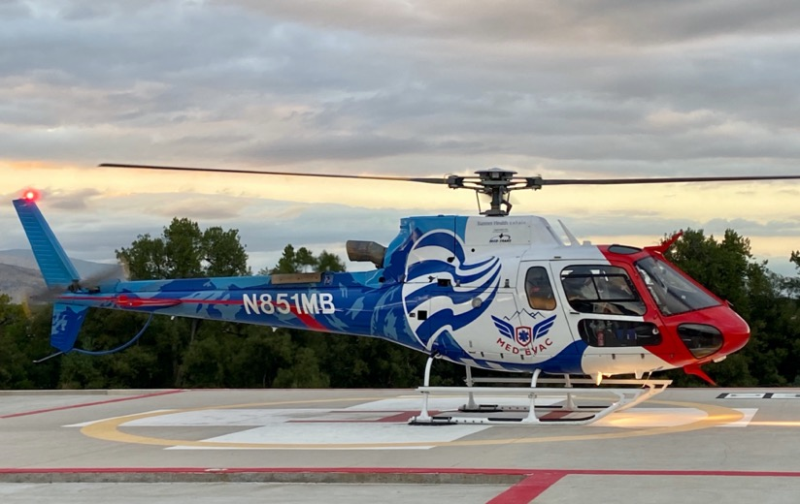
Rotor Disc Considerations
Blades flex in wind or idle speeds
Nothing over the head
Do not immediately approach
Wait until signaled by
crew/pilot
Approach from downhill

Slide 22
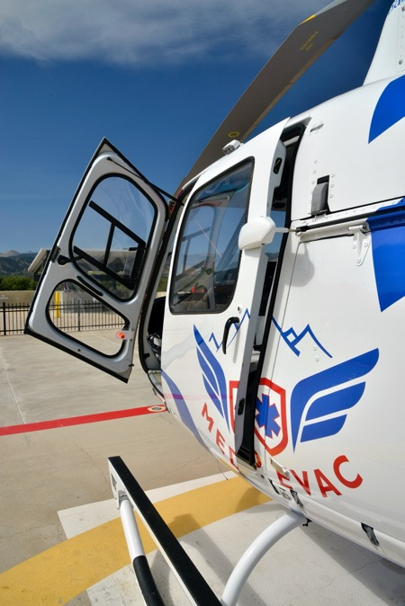
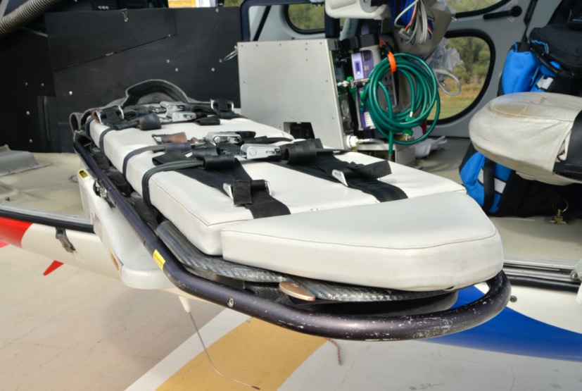
Flight Pram Loading/Unloading

Slide 23
Aircraft Accidents
Your safety comes first
Multiple hazards
Unstable aircraft position/skids
Blades may break off
Tail rotor still spinning
Fuel leak/fire
Emergency Shutdown Procedure
Start
Fuel
Battery buttons
Rotor brake

Slide 24
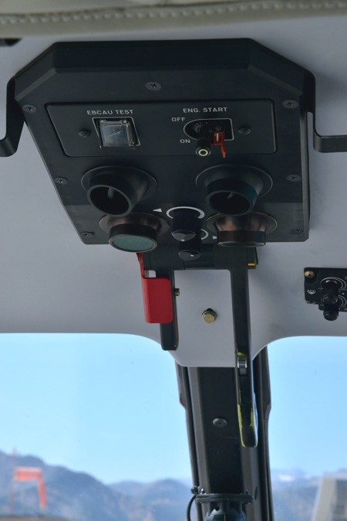
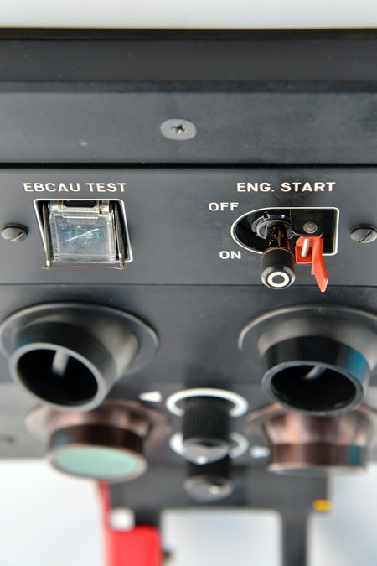
Engine start selector off

Slide 25
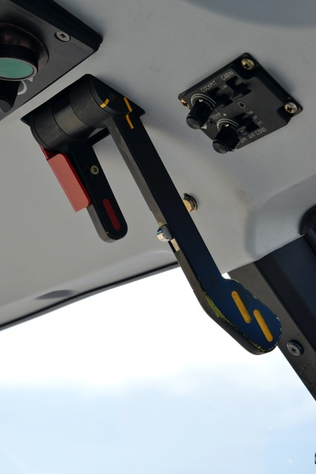
Emergency fuel shut-off handle

Slide 26
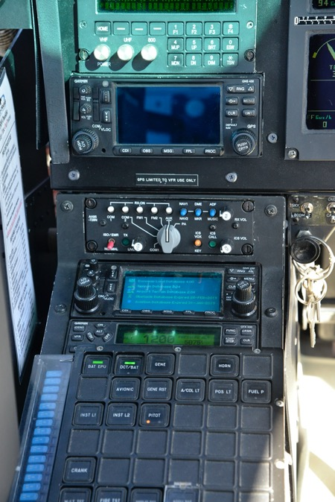
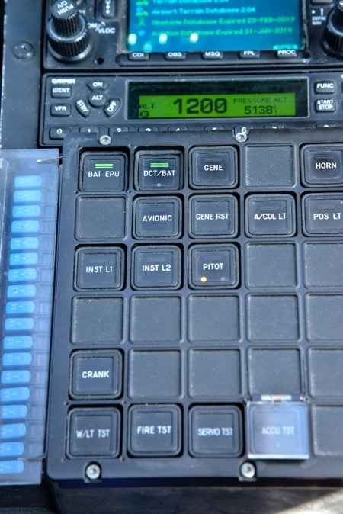
Battery Shut-off 2- buttons

Slide 27
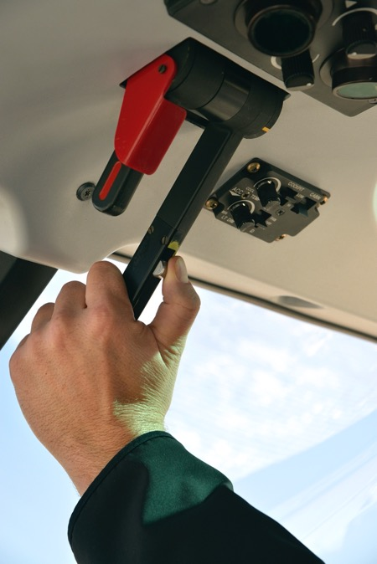
Rotor Brake

Slide 28
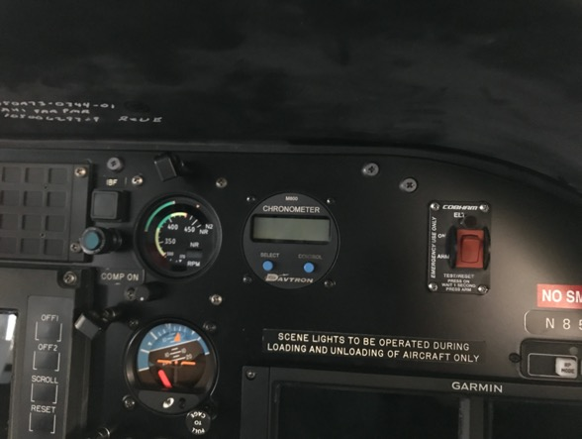
Emergency Procedures
In-flight emergency, declared by pilot
Sterile cockpit/essential communication only
Tighten seatbelt
Crash position
Upright
Knees bent at 90 degrees
ELT - Emergency Location Transmitter
Comm Spec flight following

Slide 29
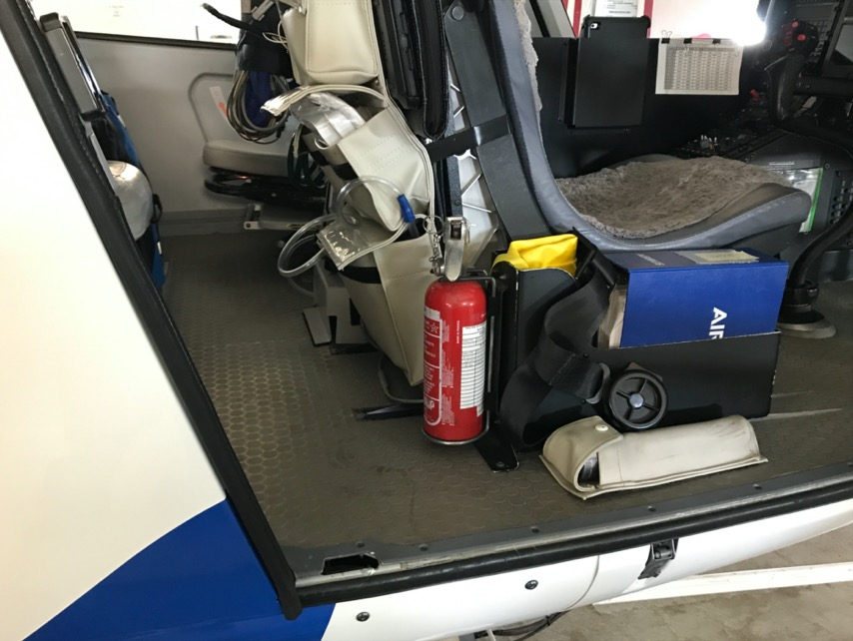
Fire Extinguishers

Slide 30
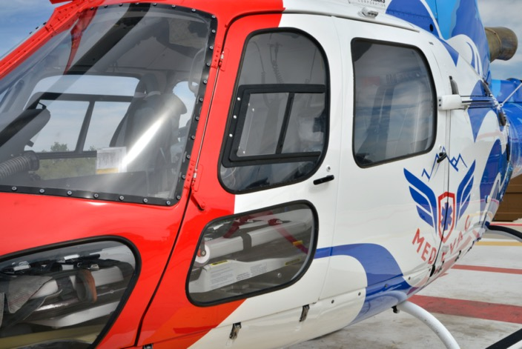
Emergency Egress

Slide 31
